Slide 1


Smart E-commerce Recommendation Optimizer
CSA0624 – Design and Analysis of Algorithm
Guided by: Presented by:
Gnanajeyaraman Kiruthika M(192421239)
Amudhavalli B(192421008)
Srivarsha M(192371010)

Slide 2
INTRODUCTION
E-commerce platforms provide thousands of products, making it difficult for customers to find the most relevant items.
A recommendation system helps customers discover products based on their interests and previous interactions.
The Smart E-Commerce Recommendation Optimizer analyzes customer behaviour such as browsing history, purchases, ratings, and product interactions.
The system generates personalized product recommendations and ranks them according to relevance.
It aims to improve recommendation accuracy, customer experience, and product discovery.

Slide 3
PROBLEM STATEMENT
Problem
Traditional e-commerce systems often display products using generic popularity, category, or static sorting methods.
Challenges
Customers receive irrelevant product recommendations.
Large product catalogs make product discovery difficult.
User preferences change over time.
Simple recommendation methods may not consider multiple behavioural factors.
Products with high relevance may not appear at the top.
Poor personalization can reduce customer satisfaction and engagement.

Slide 4
OBJECTIVE
Analyze customer browsing and purchasing behaviour.
Identify customer preferences and interests.
Generate personalized product recommendations.
Rank recommended products according to relevance.
Reduce irrelevant recommendations.
Improve product discovery and customer satisfaction.

Slide 5
EXISTING vs PROPOSED SYSTEM
Existing System | Proposed System
Generic product suggestions | Personalized recommendations
Mainly popularity-based | Behaviour-based
Limited user preference analysis | Detailed customer behaviour analysis
May recommend irrelevant products | Filters and ranks relevant products
Static product ordering | Dynamic product ranking
Limited behavioural factors | Browsing, purchase, ratings and interaction
Basic recommendation techniques | Optimized recommendation pipeline

Slide 6
Literature Review
S.No | Year of Publication | Authors | Title of The Publication | Findings | Limitations
1. | 2022 | Ethan Perez, Sam Goldman, et al. | A Systematic Study on the Recommender Systems in the E-Commerce | Compared Content-Based, Collaborative, Demographic-Based, Hybrid and Knowledge-Based recommendation techniques | Traditional approaches face challenges such as data sparsity, cold-start and scalability.
2. | 2023 | Kai Greshake, Sahar Abdelnabi, Shailesh Mishra, et al. | Recommendation System Based on Deep Learning Methods | Reviewed deep-learning approaches for recommender systems and showed their potential to improve recommendation quality | Deep-learning systems require large amounts of data and computational resources; cold-start and sparse data
3. | 2023 | Alexander Wei, Nika Haghtalab, et al. | Issues and Solutions in Deep Learning-Enabled Recommendation Systems | Demonstrated that deep neural collaborative filtering can provide personalized recommendations | Performance depends heavily on data quality and scalability of the recommendation system
4. | 2023 | Zou et al. | E-Commerce Personalized Recommendations: A Deep Neural Collaborative Filtering | Examined both rating prediction and Top-N ranking, highlighting deep learning's role | Deep-learning models can be complex, computationally expensive
5. | 2024 | Zhang et al. | Emerging Trends of Recommender System for E-Commerce | Identified ML, deep learning, NLP, LLMs and recommendation as emerging approaches | Major remaining issues include cold-start, data sparsity, privacy, computational cost

Slide 7
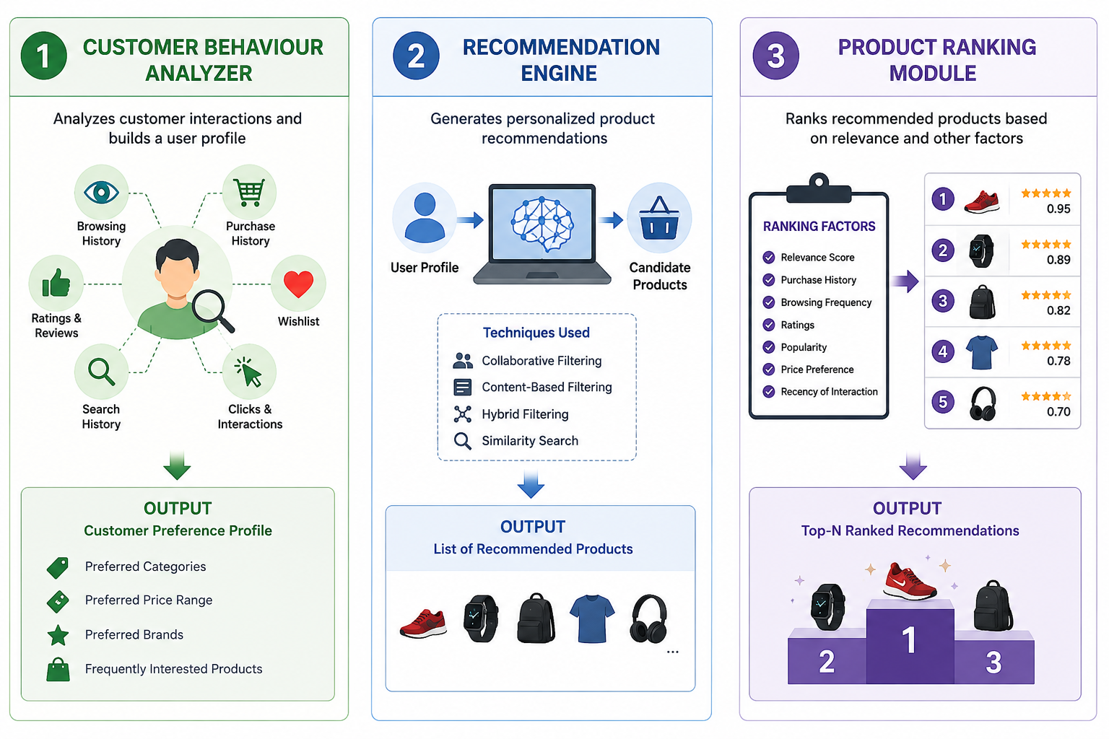
Module 1: Customer Behaviour Analyzer
Purpose
To understand customer interests and preferences by analyzing their interactions with the e-commerce platform.
Input Data such as Browsing history, Purchase history, Product ratings, Search history, Clicks and product views, Wishlist/favourites, Time spent on products
Output
A Customer Preference Profile containing: Preferred categories, Preferred brands, Price range, Frequently viewed products, Frequently purchased products

Slide 8
Module 2: Recommendation Engine
Purpose
To generate products that are most relevant to each customer.
Working
Receives the customer preference profile.
Identifies similar products/customers.
Calculates product similarity.
Generates a list of candidate products.
Removes already purchased or irrelevant products.
Sends candidate products to the Product Ranking Module.

Slide 9
Module 3: Product Ranking Module
Purpose
To arrange recommended products from most relevant to least relevant.
Ranking Factors
Customer-product similarity
Previous purchase behaviour
Product ratings
Browsing frequency
Category preference
Price preference
Product popularity
Recent interactions

Slide 10
RESULT & IMPLEMENTATION
Expected/Implemented Results
The system provides:
Personalized product recommendations.
Improved product relevance.
Dynamic ranking of recommended products.
Better utilization of customer behaviour data.
Faster product discovery.
Reduced irrelevant recommendations.
Improved customer engagement.

Slide 11
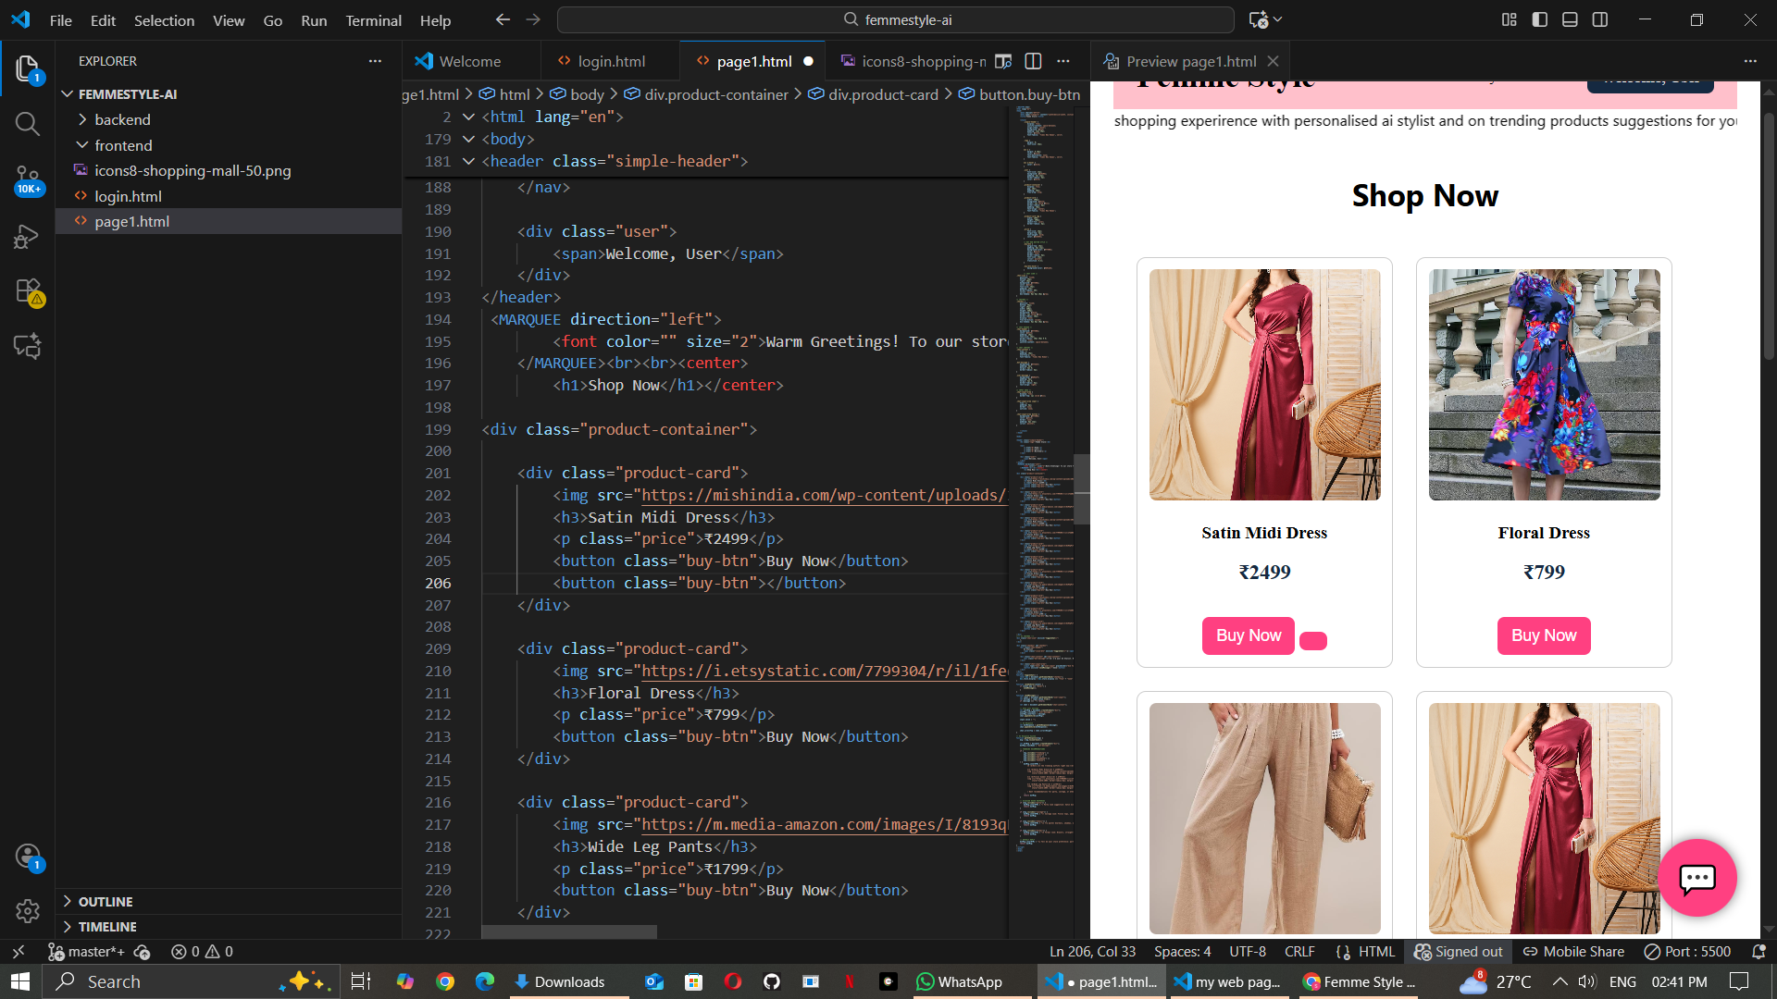
RESULT & IMPLEMENTATION

Slide 12
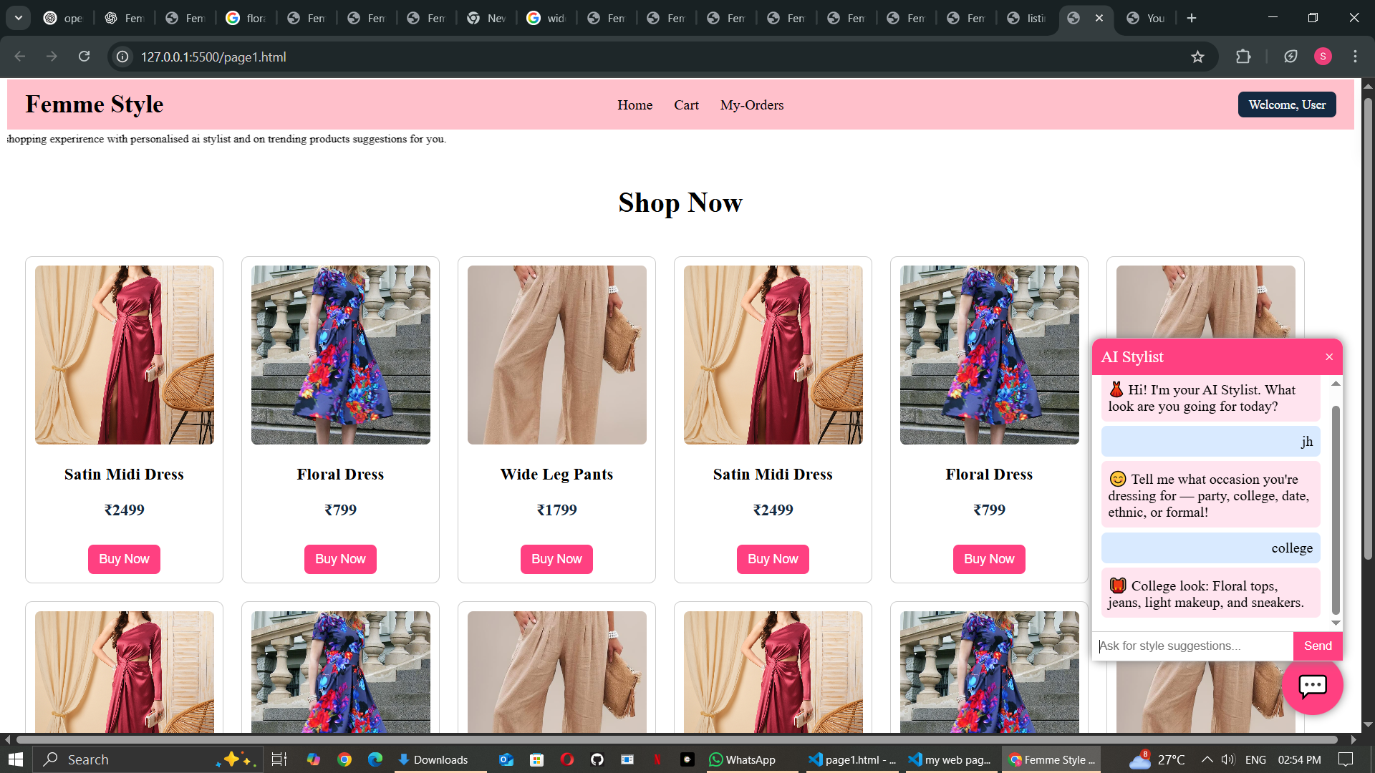
RESULT & IMPLEMENTATION

Slide 13
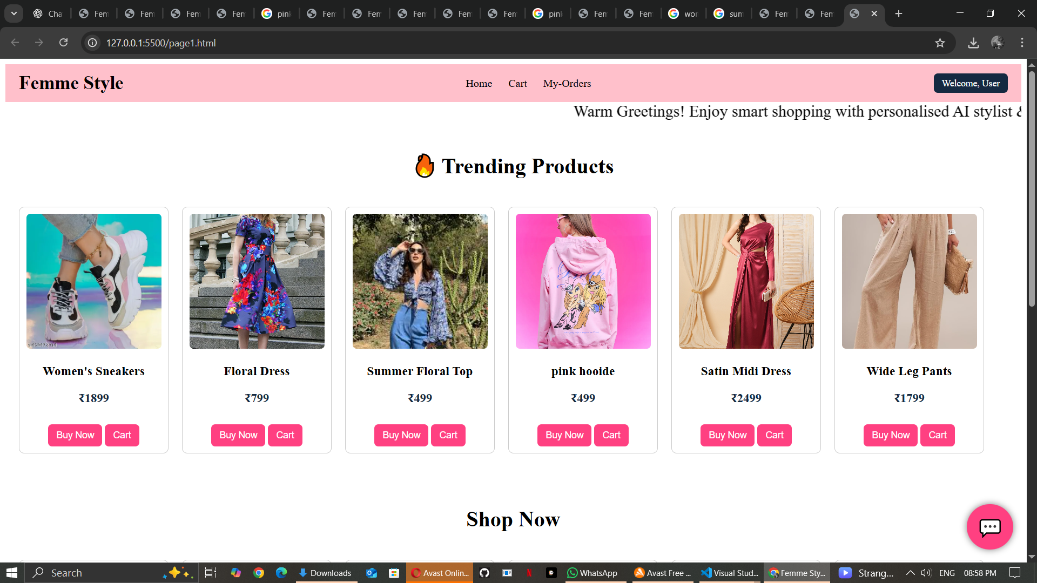
RESULT & IMPLEMENTATION

Slide 14
CONCLUSION
The Smart E-Commerce Recommendation Optimizer provides an intelligent approach to personalized product recommendations. The system analyzes customer behaviour, generates relevant product suggestions, and ranks them according to their relevance.
The integration of Customer Behaviour Analysis, Recommendation Engine, and Product Ranking helps overcome the limitations of generic recommendation systems.

Slide 15
REFERENCES
[1] E. Perez, S. Goldman, et al., “A systematic study on the recommender systems in the e-commerce,” 2022.
[2] K. Greshake, S. Abdelnabi, S. Mishra, et al., “Recommendation system based on deep learning methods,” 2023.
[3] A. Wei, N. Haghtalab, et al., “Issues and solutions in deep learning-enabled recommendation systems,” 2023.
[4] Z. Zou, et al., “E-commerce personalized recommendations: A deep neural collaborative filtering approach,” 2023.
[5] Y. Zhang, et al., “Emerging trends of recommender system for e-commerce,” 2024.

